Slide 1
Final Year Dissertation Comparing Internet Censorship in Ireland vs Israel
<p> Chris Casey, 20334271
ccasey3@tcd.ie </p>
Dr. Stephen Farrell

Slide 2
Internet Censorship Introduction
01
<p> This section outlines some background on internet censorship and the research motivation for this thesis </p>

Slide 3
Research Motivation
Privacy
Digital Rights
Freedom of Information
Corporate trust
Governmental trust
Rising censorship
New Frontier
Profitable
Digital Diplomacy
Legislation

Slide 4
The Internet Misconceptions
"The Internet is not a public sphere. It is a private sphere that tolerates public speech." ~ Clay Shirky
Operation
Content
Transparent
Decentralised
Meritocracy
Unmanipulated
Permanent
Unbiased

Slide 5
02
Internet Censorship Mechanisms
<p> How is internet censorship conducted? </p>

Slide 6
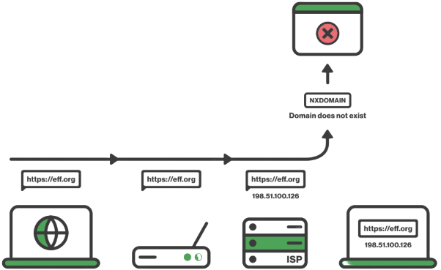
Internet Censorship Mechanisms
Application Layer (5)
DNS Filtering
Keyword Filtering
2. Network Layer (3)
IP Blocking
3. Non-Specific
Deep Packet Inspection
Points of Control
Internet censorship occurs at various levels of the OSI model

Slide 7
Measuring Censorship Methodology
03
<p> Discussing the differences and similarities in approach, motives and impact </p>

Slide 8
Measuring Censorship Methodology
<p> OONI Probe </p>
Insert info on OONI probe
<p> Virtual Machine </p>
Insert info on VM and provider used
<p> Data Analysis and Comparison </p>
Insert info on data analysis, comparison of sources

Slide 9
Results Ireland vs Israel
04
<p> Discussing similarities and differences in approach, motives and impact </p>

Slide 10
Results Ireland vs Israel
Ireland
Israel
Add text here
And here

Slide 11
Ongoing Research
05
<p> An outline of the work to come before April </p>

Slide 12
Gathering Ground Truth
<p> Title here </p>
Little thing here
<p> another title </p>
More stuff
<p> last title </p>
More stuff

Slide 13
OONI Proposed Contribution
Basic goal add more tests
Something more ambitious here

Slide 14
THANK YOU!
Chris Casey
Ccasey3@tcd.ie
20334271
Do you have any questions?

